Slide 1
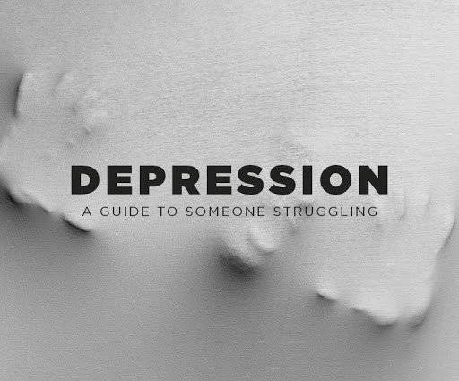
Depression Problem Aging
Institution
Course
Name

Slide 2

Introduction
Old age is seen as a time of rest, reflection and opportunity to carry out things that were put off while one was taking care of family.
Aging process is not always that idyllic.
Late-life events such as inability to get engaged in once-cherished activities, loss of family members and friends can influence one’s emotional well-being.
Such issues tend to give rise to bring about negative emotions such as lowered self-esteem, loneliness, anxiety and sadness (Robinson, 2015).

Slide 3

Discussion of Depression Issue
Clinical depression in late-age is common.
This does not mean that depression is a normal thing.
Depression affects many Americans who have 65 years and above.
Only a slight percentage of these people get treated.
This might be attributed to the fact that these people indicate symptoms of depression differently (Reisig, 2018).

Slide 4

Cont…,
Depression impacts the elderly differently than young people.
In the elderly, depression is accompanied by other additional medical illnesses.
Depression the elderly lasts longer compared to young people.
Depression in the elderly is linked with increased risk of cardiac diseases.
Depression in the elderly is linked with increased risk of death from illness.

Slide 5

Cont…,
Patients with physical illnesses have indicated that the presence of depression significantly increases the probability of death.
Depression has been linked with increased risk of death in the event that heart attack occurs (Hill, 2018).

Slide 6

Recommendations for Solving Depression in Aging
The elderly people should be encouraged to consult with a physician before making any dietary changes.
Consult a psychologist who has specialized in aging issues so that he can tailor a strategy that can help the patient.
Be tactful when handling an older person who has a fragile self-esteem.
an older person with a fragile self-esteem might interpret well-intentioned encouragement as a proof of his deteriorating health condition.

Slide 7

Conclusion (Part 2)
People take old age period as a time for relaxing.
This is the time when clinical depression might kick-in.
This might be caused due to:
Loss of a family or friend.
Chronic and debilitating medical disorders.
In ability to take part in activities that once were cherished.

Slide 8

Cont…,
Unfortunately, aging process is not that idyllic as people might think.
Uninvited life changes might change life to become miserable (Robinson, 2015).
Such a point welcomes unforeseen issues that might lead to depression at old age.

Slide 9
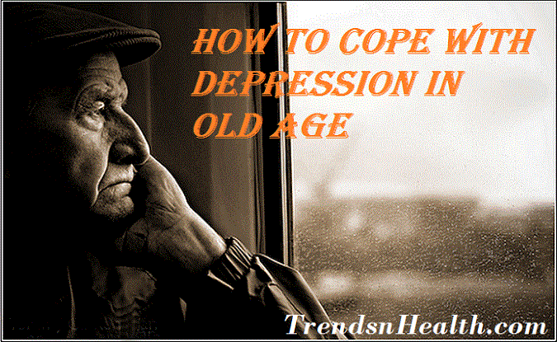
Solution
Apply either of the following therapy methods:
Psychodynamic therapy.
Interpersonal therapy.
Cognitive behavioral therapy
Respect individual preferences.
Be tactful; encourage the elderly with depression so that they can improve.

Slide 10
References
Robinson, R. (2015). Later-Life Crisis: Towards a Holistic Model. Journal of Adult Development, 22(1), 38–49. https://doi.org/10.1007/s10804-014-9199-5
Reisig, R. (2018). Criminal Victimization, Depressive Symptoms, and Behavioral Avoidance Coping in Late Adulthood: The Conditioning Role of Strong Familial Ties. Journal of Adult Development, 25(1), 13–24. https://doi.org/10.1007/s10804-017-9270-0
Hill, B. (2011). A Preliminary Investigation of Quality of Life Satisfaction Reports in Emerging Adults With and Without Developmental Coordination Disorder. Journal of Adult Development, 18(3), 130–134. https://doi.org/10.1007/s10804-011-9122-2

